Slide 1




Minimizing Customer Churn
Analysis and Recommendations for Telecommunications Companies

Slide 2
Churn Occurs When customers cancel service subscription
20%
50X
65M
Revenue spend on Acquisitions
Cost of Acquisitions vs Retention
Monthly Losses due to Churn

Slide 3
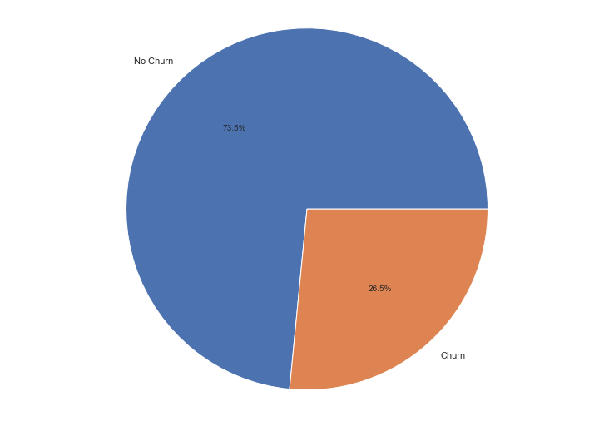
Project Summary
Data
Origin: IBM Customer Retention Dataset
Target Variable: Customer Churn
Features: 3 Continuous, 17 Categorical
Objectives
Build interpretable classification model to optimize identification of at-risk customers
Identify most prominent features which affect customer churn
Optimize F1

Slide 4
The Process
EDA
Collection / Cleaning
Feature Engineering
Feature Selection
Model Building
Dataset pulled from Kaggle
Data cleaning and preprocessing
Explored target variable “Churn”
Identified predictor variables with greatest impact on churn
Generate ideas for feature engineering
Domain knowledge combined with EDA
Hypothesis testing to determine value
RFE
VIF
Polynomial Interactions
Logistic Regression
KNN
Decision Trees
Random Forest
Bagging / Boosting
Voting Classifier

Slide 5
Project Summary
Data

Slide 6
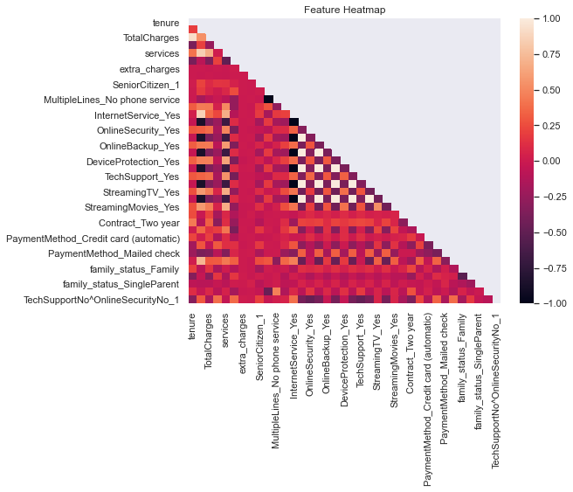
Checking for Correlations
Minimal collinearity in dataset
Primary concerns include services
InternetService
OnlineSecurity
OnlineBackup
DeviceProtection
StreamingTV
StreamingMovies
Etc..

Slide 7
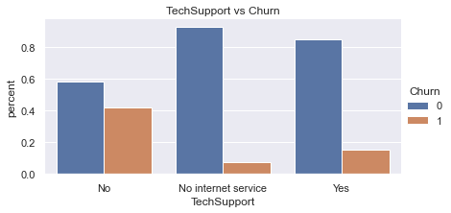
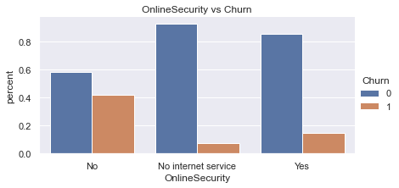
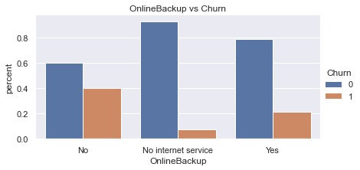
EDA – High Collinearity
Nearly identical churn rates across ‘services’ predictors
Customers significantly more likely to churn if they:
Pay for Internet
Do not Pay for Services
Feature Engineering:
Paid Services Count
Avg Price per Service
Has Internet

Slide 8
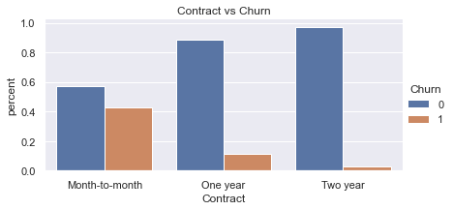
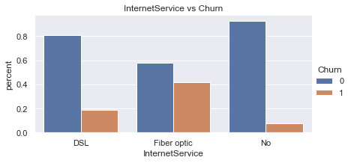
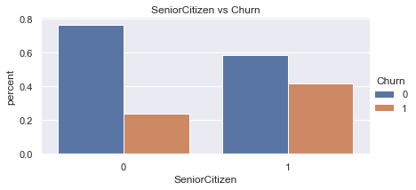
EDA – Categorical Features
Significant difference in Churn Rates between various categorical features
As expected, longer contracts correlate with significantly lower churn
Surprisingly, major correlation between churn and use of Fiber Optic

Slide 9
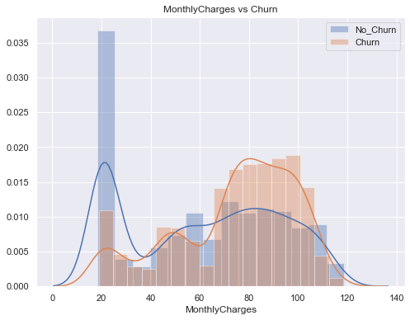
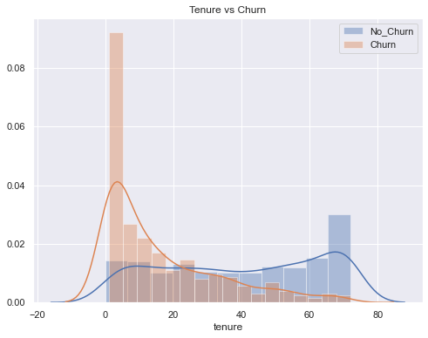
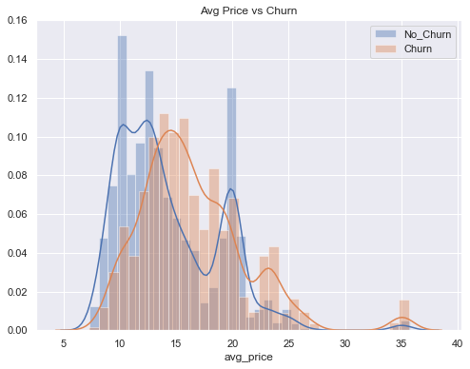
EDA – Continuous Features
Churn occurs more frequently as Monthly Charges increase
As expected, churn vs no_churn distributions vary greatly with respect to tenure
Similar to Monthly Charges, people that pay more per service churn more

Slide 10
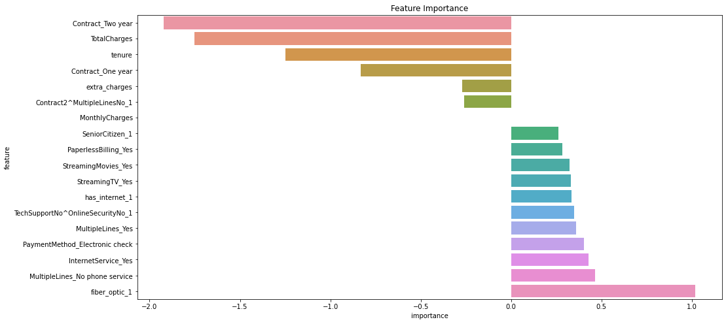
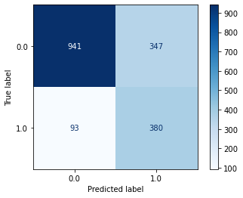
Best Model: Logistic Regression, Upsampled, Best Features
Accuracy: 75%
Precision: 52%
Recall: 80%
F1: 63%
AUC: 76%

Slide 11
Suggestions
Upsell Contracts
Fiber Optic Service
Reduce Usage of eCheck
2 Year Contracts contribute the most to prolonged subscription
Improve performance of Fiber Optic service to retain customers
Usage of eChecks increases churn rate

Slide 12
Suggestions
Sell Cheap First
Reduce Paperless Billing
TechSup, WebSec
Increase stickiness, slowly. Customers with more tenure will be more willing to accept pricey services
Usage of Paperless Billing increases change of churn
Lack of TechSupport or OnlineSecurity increases churn

